Slide 1
PROVISION INFRASTURE WITH AZURE DEVOPS
Create Utilility to Transpile BICEP to ARM
Section 7

Slide 2
GOAL
Create Utility to Transpile BICEP to ARM
Develop Powershell Script with Azure CLI to Transpile BICEP to ARM
Section 7
Notes:
Hello and Welcome to Section 7
The goal of this particular section is to develop a powershell script in combination with the Azure CLI to transpile bicep to arm.

Slide 3




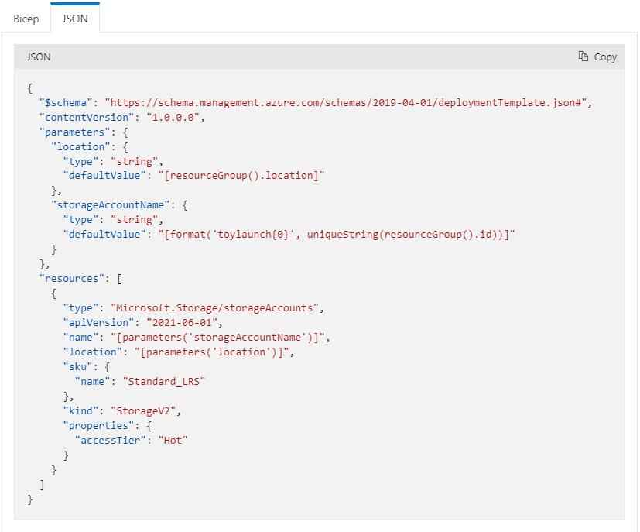
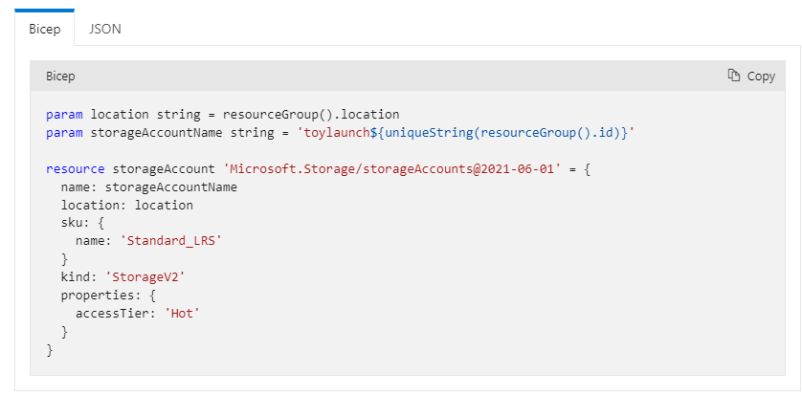
Transpile BICEP to ARM
What is BICEP: Bicep is a a declarative language language used for deploying Azure Resources.
BICEP Transpiles to ARM.
Notes:
Alight alright guys,
In the last couple of lessons we have already established that BICEP is a declaritive language that is used for deploying azure resources.
However, BICEP in its natural form cannot be interpreted by the Azure Resource Manager.
The Azure Resource Manager requires a file to be in the form of an ARM template which is constructed in JSON format.
So therefore, we need to write and develop a utility that transpiles a BICEP file into a JSON ARM file.
We can do this by writing a Powershell Script and then invoke the usage of Azure CLI to the actual transpilation of BICEP to ARM.
So the aim and objective of this section is to develop that resuasable utility of transpiling BICEP to ARM.
Let’s meet again in the next lecture to discuss the technical spefication of the script that we are going to develop.
Goodbye!

